Slide 1
Children and Families support across Leeds
Summer 2024

Slide 2
Hello and Welcome
Thank you for all joining us today. The aims of this briefing are:
To provide an overview of the support and activities available to ALL children and families in Leeds
Share some specific services for children and families in need
Provide links and resources to professionals

Slide 3
HEALTHY HOLIDAYS - COMMUNITY ORGANISATION ACTIVITIES
The following Community Organisations have been funded to offer Healthy Holidays activities across Leeds during the 2024 Easter, Summer, and Christmas school holiday periods.
Healthy Holidays is run in partnership with Leeds City Council and is funded by the Department for Education’s Holiday Activity and Food programme.
Healthy Holidays tackles food insecurity and hunger, isolation and inactivity by providing fun activities, and healthy meals.
It is free and open to school age children and young people who receive benefit-related free school meals; and those who struggle to access healthy food and safe activities in holiday periods.
Contact your local provider, on the next slides, to book a place.

Slide 4
Community Organisation | Area (West/East/South) | Postcode | Email address
BARCA | Bramley and Stanningley (W) | LS13 3JT | healthyholidas@barca-leeds.org
CATCH Leeds | Gipton and Harehills (E) | LS8 3QY | accounts@arkleeds.co.uk
Champions Community Sport and Health CIC | Hunslet and Riverside, Beeston and Hokbeck, Middleton Park, Burmantofts & Richmond Hill (S) | LS11 5HJ | sgilmore51@icloud.com
Complete Woman CIC | Burmantofts and Richmond Hill (S) | LS9 8SS | info@completewoman.co.uk
Connecting Crossgates | Crossgates, Swarcliffe, Stanks, Whinmoor, Seacroft (E) | LS15 8UF | karen@connectingcrossgates.com
Dance Action Zone Leeds | Middleton Park (S) | LS10 4LF | community@dazl.org.uk
East Leeds Project | Harehills (E) | LS8 3LF | claire@eastleedsproject.org
Getaway Girls | Harehills, Gipton, Seacroft/Killingbeck (E) | LS14 6SG | info@getawaygirls.co.uk
GFS Community Enterprise (The Old Fire Station) | Gipton (E) | LS9 6NL | families@theoldfirestationgipton.org.uk
GIPSIL | Gipton, Harehills, Richmond Hill and Seacroft (E) | LS9 6NL | nicola.french@gipsil.org.uk
Give A Gift | Harehills & Gipton (E) | LS8 4HS | hana@giveagift.org.uk
Groundwork Yorkshire (Ardsley and Lofthouse) | Ardsley, Robin Hood & Lofthouse (S) | LS27 9SL | nicola.ramsden@groundwork.org.uk

Slide 5
Community Organisation | Area (West/East/South) | Postcode | Email address
Groundwork Yorkshire (Morley) | Morley South (S) | LS27 9SL | nicola.ramsden@groundwork.org.uk
Groundwork Yorkshire (Rothwell) | Rothwell (S) | LS27 9SL | nicola.ramsden@groundwork.org.uk
Guiseley Community Foundation | Guiseley and Rawdon (W) | LS20 8JR | enquiries@guiseleycommunityfoundation.org.uk
Hamara Healthy Living Centre | Hunslet & Riverside (S) | LS11 6RD | admin@hamara.co.uk
Health for All (Middleton and Belle Isle) | Middleton Park (S) | LS10 4HX | richard.weaver@healthforall.org.uk
Health for All (Swarcliffe and Whinmoor) | Swarcliffe and Whinmoor | LS10 4HX | richard.weaver@healthforall.org.uk
Health for All (Beeston and Cottingley) | Beeston and Cottingley (S) | LS10 4HX | richard.weaver@healthforall.org.uk
Holbeck Together | Beeston & Holbeck (S) | LS11 9NS | info@holbecktogether.org
Hunslet Club | Hunslet & Riverside (S) | LS10 1BP | admin@hunsletclub.org.uk
Hunslet Rugby Foundation | Middleton (S) | LS11 5DJ | michael.nuttall@hunsletrugbyfoundation.co.uk
Hyde Park Source | Little London & Woodhouse (W) | LS3 1HH | kelly@hydeparksource.org
Kirkstall Valley Development Trust | Kirkstall (W) | LS5 3JN | kirsty.ward@kvdt.org.uk

Slide 6
Community Organisation | Area (West/East/South) | Postcode | Email address
Leeds GATE Gypsy and Traveller Exchange | Burmantofts & Richmond Hill (E) | LS9 0BD | grace@leedsgate.co.uk
Leeds Mencap | Burmantofts & Richmond Hill (E) | LS9 9LU | abigail.cunningham@leedsmencap.org.uk
Leeds United Foundation (Armley) | Armley (W) | LS12 1JZ | fitleeds@leedsunited.com
Leeds United Foundation (Beeston) | Beeston (S) | LS11 8PN | fitleeds@leedsunited.com
Leeds United Foundation (Halton Moor) | Temple Newsam (S) | LS9 0JY | fitleeds@leedsunited.com
Left Bank Leeds | Headingley & Hyde Park | LS6 1LJ | hello@leftbankleeds.org.uk
Moortown West Community Association | Alwoodley (E) | LS17 5DX | info@moortownwest.org.uk
New Wortley Community Association | Armley (W) | LS12 1LZ | harriet.smith@newwortleycc.org
Nigerian Yorkshire Communities Network UK CIC | Armley (W) | LS12 1QG | nigeriansyorkshirenetwork@gmail.com
Reestablish | Beeston & Holbeck (S) | LS11 8ND | reestablish.info@gmail.com
Seacroft Community on Top | Killingbeck and Seacroft (E) | LS14 6RD | seacroftCommunityOntop@outlook.com
St Giles Trust | Killingbeck and Seacroft (E) | LS7 3HZ | patsy.joyce@stgilestrust.org.uk

Slide 7
Community Organisation | Area (West/East/South) | Postcode | Email address
St Luke’s Cares | Beeston & Holbeck (S) | LS11 6JQ | holidays@stlukescares.org.uk
Stitch-Up CIC | Meanwood/Moortown (E) | LS7 2AH | stitchup.liz@gmail.com
Team Daniel | Yeadon (W) | LS27 7BX | teamdanielholidayclub@gmail.com
The Tetley (Project Space Leeds) | Beeston & Holbeck (S) | LS10 1JQ | info@thetetley.org
The Youth Association | Little London & Woodhouse (W) | WF1 1LR | info@youth-association.org
The Zone | Alwoodley (E) | LS17 6AQ | alex@thezoneleeds.org

Slide 8
There are also projects run by the schools and the Council, and the details are here:
https://www.leeds.gov.uk/children-and-families/healthy-holidays
All parents/carers need to register their children/ young people at:
https://healthyholidays.leeds.gov.uk/
to check eligibility

Slide 9
The Child Friendly Guide to Summer in Leeds
When it comes to child friendly things to do, Leeds is the place to be! Whether it’s days out, days in, new experiences or out of this world experiences. We’ve put together this ultimate guide of the best places to visit this Summer!
Find the full guide here:
The Child Friendly Guide to Summer in Leeds (wearechildfriendlyleeds.com)

Slide 10
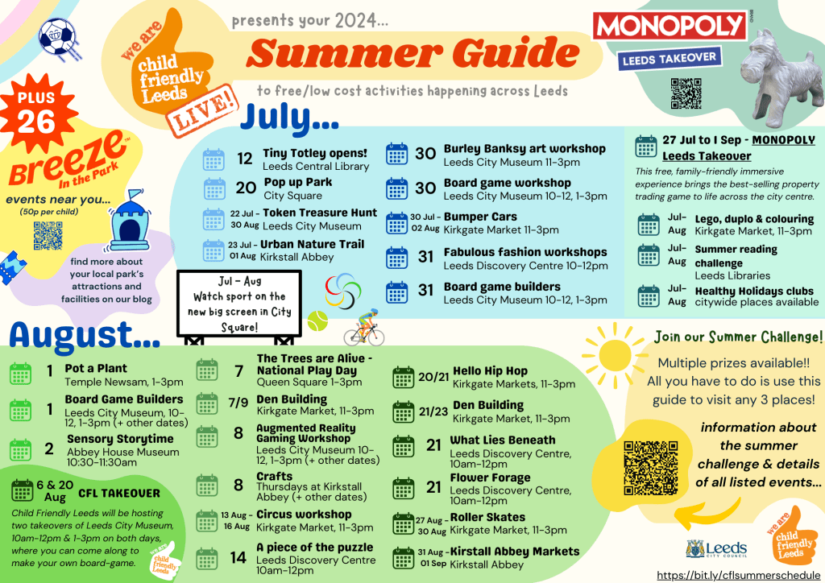
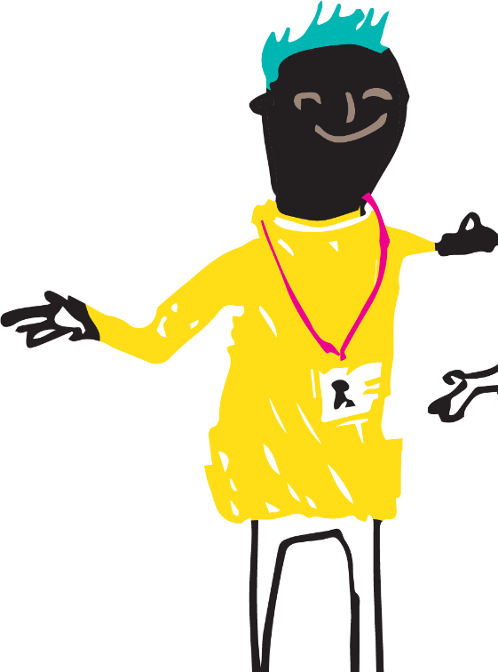
Area Key
South
West
East
Central

Slide 11
Breeze in the Park
Get caught up in sun, fun, chills and thrills with, interactive play system, arts zone, food and classic inflatables. Session times: 12noon – 2.30pm and 3pm – 5.30pm
https://www.breezeleeds.org/breeze-in-the-park/
Wed, 24 July | Cooper’s Field (previously Parkside Fields), Belle Isle, LS10 3HF
Thurs, 25 July | West Park Leeds RUFC, The Sycamores, Bramhope, LS16 9JR
Fri, 26 July | Queens Park, Pudsey, LS28 7FB
Sat, 27 July | Street Lane Playing Fields, Gildersome, LS27 7HY
Mon, 29 July | Armley Park, Stanningley Rd, Leeds LS12 3LW
Tues, 30 July | Harehills Park, Harehills, LS9 6ND
Wed, 31 July | Cross Flatts park, Beeston, LS11 7BQ
Thurs, 1 Aug | Garnett Field, Otley, LS21 1AS
Fri, 2 August | East Ardsley Recreation Ground,Main St, East Ardsley, WF3 2AP
Sat, 3 August | Western Flatts Cliff Park, Green Hill Lane, Wortley, LS12 4HG
Mon, 5 August | Haslewood Park, Oxton Way, Burnantofts, LS9 7UZ
Tues, 6 August | Kirkstall Abbey, Kirkstall, LS5 3EH
Wed, 7 August | Scatcherd Park, Morley, Leeds LS27 9JP
Thurs, 8 August | Tinshill Recreation Ground, LS16 6BN
Fri, 9 August | Hainsworth Park, Farsley, LS28 5ES
Sat, 10 August | Horsforth field Playground, Drury Avenue LS18 4BR
Mon, 12 August | East End Park, East Park Parade, LS9 9NG
Tues, 13 August | Nunroyd Park, Yeadon, LS19 7HR
Wed, 14 August | Potternewton Playing Fields, Scott Hall Road, LS7 2EE
Thurs, 15 August | Wetherby Ings, Wetherby, LS22 5FN
Fri, 16 August | Middleton Park, LS10 3SH
Sat, 17 August | Bramley Park, LS13 3PG
Mon, 19 August | Springhead Park, Rothwell, LS26 0DY
Tues, 20 August | Seacroft Village Green, LS14 6JS
Wed, 21 August | Primrose Valley, Halton Dean, LS15 7JA
Thurs, 22 August | Manston Park, Cross Gates, LS15 8HA

Slide 12
Other Useful Links
Activities at Home
https://www.barnardos.org.uk/blog/7-low-cost-activities-do-your-kids?utm_source=X&utm_campaign=Summer_Holidays&utm_medium=organic&utm_content=Low_cost_activities&s=08
Activities at Home
https://indyschild.com/70-things-to-do-with-kids-now-that-were-all-stuck-at-home/
Love Exploring App
https://www.visitleeds.co.uk/love-exploring/
Healthy Indoor Activities
https://www.nhs.uk/healthier-families/activities/indoor-activities-for-kids/
NSPCC
https://www.nspcc.org.uk/about-us/news-opinion/2022/nspcc-helpline-children-home-alone/

Slide 13
School Uniform Exchange
Good quality school uniform is going to waste when it could be shared. Leeds School Uniform Exchange makes it easy for families to pass on good quality school uniform that’s no longer needed and, instead of buying new, find items of school uniform, for free!
They also support people to start exchanging by setting up uniform sharing schemes at schools, online or in neighbourhoods across Leeds.
https://leedsuniformexchange.org.uk/

Slide 14
Families might need a little extra help with food and meals at home over the summer.
The Leeds Food Aid Network website hosts lots of information and services that can support families in need over the summer period.
Find it here:
Leeds Food Aid Network

Slide 15
Leeds Food Aid
Emergency Food
Food Bank Map
Food Drop Ins
Food Pantries in Leeds
As well as links to other support services

Slide 16
Summer Meal Deals
Children can access a hot or cold meal for just £1.
Ella's baby food pouches are free for children under 18 months with any purchase.
Beeston – Old Lane (South)
Killingbeck – Killingbeck Drive (East)
Middleton – Holme Well Road (South)
Pudsey – Owlcotes Shopping Centre (West)
Dewsbury – Mill Street West (South)
Glasshoughton – Leeds Road (West)
Pausa Café is offering a free kids menu for every £4 spent in their in-store cafes.
Holbeck - Whitehall Rd (South)

Slide 17
Summer Meal Deals
Children under 16 eat free at Morrisons cafe all day, every day when an adult spends £4.50 or more on a meal.
Bramley – Swinnow Road (West)
Guiseley – Otley Road (West)
Horsforth – Town Street (West)
Hunslet – Church Street (South)
Kirkstall – Savins Mill Way (West)
Morley – Albion Street (South)
Rothwell – Jail Yard Parade (South)
Yeadon – High Street (West)
Available from Monday to Friday during school holidays kids can eat free at Tesco cafes when an adult makes any purchase in the cafe.
Seacroft – Seacroft Avenue(East)
Find more deals here: https://yorkshiretots.com/kids-eat-free-yorkshire/

Slide 18
There's lots of support for families with babies through Leeds Baby Bank.
They give families new and pre-loved buggies, cots, toys and children’s clothes and distribute essentials like nappies and formula milk in some of the most deprived areas of Leeds.
Find more information here:
https://www.leedsbabybank.org/about/

Slide 19
Leeds Baby Bank Events
They hold wonderful community events every month, local to families in key areas of Leeds. These events aim to support people to access support services, community activity and longer-term support. They also gift families an essential top-up of items like nappies, wipes, formula and toiletries.
They kindly ask that families only attend one session per month; this helps them to distribute stock fairly in each community. Parents only eligible if child is living with them. Do not bring or invite relatives of the child.
WEST LEEDS
Little Owls Nursery, Armley
Leeds LS12 1UT
1st Thursday of each month
10am - 12pm
EAST LEEDS
Gipton South Children’s Centre
Coldcotes Grove, Leeds LS9 6QJ
4th Thursday of each month
10am - 12pm
REFERRAL ONLY
The Compton Centre, Harehills
Leeds LS9 7BG
SOUTH LEEDS
New Bewerley Children’s Centre
Dismarck Road, Leeds LS11 6TB
3rd Thursday of each month
10am - 12pm

Slide 20
Other Support Services
Young people's mental health and wellbeing website.
https://mindmate.org.uk/
Confidential support line for children, young people, their parents and carers
https://www.lslcs.org.uk/services/night-owls-helpline/
Adult mental health and wellbeing website.
https://www.mindwell-leeds.org.uk/
Advice and support with money related matters such as debt, money, energy and utilities.
https://www.leeds.gov.uk/leedsmic
Directorate for services and support in Leeds
https://helpinleeds.com/
Safeguarding, support, parenting advice and guidance.
https://www.leedsscp.org.uk/

Slide 21
Any
Questions?

