Slide 1
An overview of Leeds Housing Options

Slide 2
Who are Leeds Housing Options?
Leeds Housing Options is a statutory public service with a focus on homelessness prevention assisting those who are experiencing a homelessness or housing related issue. Housing Options conduct homeless assessments in line with the Homeless Reduction Act 2018, provide advice and assistance with securing suitable alternative housing solutions and may offer temporary housing solutions dependent on an applicants need. We also provide advice and guidance with searching for private rented accomodation and support move on from temporary accommodation.
The primary aim is to prevent applicants from becoming homeless and to ensure that suitable and affordable accommodation is available.
Homeless duties accepted in 2023 | 5398
Prevention accepted- Threatened with homelessness | 3065 | 56.78%
Relief accepted- Homeless on the day | 2333 | 43.22%
Advice only/Early closure minus DTR | 891 | 13.51%

Slide 3
Advice and Assessment Conduct homeless applications for those threatened with homelessness or street homeless. Make legal decisions and provide personalised advice to individuals/families
Private sector Work to procure properties, work with landlords and help to support failing tenancies. They do consultations with customers and offer advice on how to obtain private rental.
Domestic Abuse We have a specialist team set up to attend the Daily MARAC meetings and conduct DA assessments
Temporary Accommodation Offers and manages all accommodation placements and supports rough sleeper cohort
Hospital discharge
Conduct homelessness assessments with individuals who are bed-blocking and homeless on discharge
Review Panel If a customer is dissatisfied with a decision they can usually review the decision within 28 days. The contact for them is reviewpanel@leeds.gov.uk
Migration Team
Conduct homelessness assessments for people leaving NASS accommodation or carrying out family reunions giving appropriate advice and support to move on, liaise with MEARS about customers in NASS and safeguarding. Provide a direct link between third party organisations and the wider service for migration enquiries. LAASLOenquiries@leeds.gov.uk

Slide 4
DTR process
A Duty to Refer is a notification from a public body or professional / third sector organisation that an applicant is threatened with homelessness. By completing a Duty to Refer you are requesting a homeless assessment for your client, upon receipt of your referral this will be reviewed by Housing Options to triage your enquiry to the appropriate team. Please note this pathway is only for individuals who are experiencing homelessness, and the inbox is for assessment requests only. Any updates on assessments or general enquiries can be directed to our main inbox housing.options@leeds.gov.uk
There are two ways to send a duty to refer:
Via email with a completed Duty to Refer form to dutytorefer@leeds.gov.uk (if you do not have the Duty to Refer form please email the inbox to request the form to be sent to you)
Or via the online portal Jigsaw if you have an account: https://live.housingjigsaw.co.uk/alert/duty-to-refer
CONSENT MUST BE GIVEN FROM THE CUSTOMER BEFORE THE REFFERAL CAN BE MADE!

Slide 5
an overview of the assessment process
Eligibility An applicant has to provide evidence of their status in the UK and accessibility to public funds. We require a passport or birth certificate for UK nationals, proof of residence for foreign nationals i.e. a residence. EU nationals may also have to provide evidence of employment. permit or sharecode. If someone is not eligible, we may refer families to CSWS and singles to PAFRAS for support.
Step 1- Professional sends DTR via the inbox or jigsaw for a request for homelessness assessment
Step 2- Referral is triaged by an advisor and added on the que for an assessment (1-3 week usual time frame). The assessment will be passed to the correct team (DA, Migration etc). If customer is homeless on the night please contact us via phone or Merrion House.
Step 3- Advisor contacts customer for assessment and carried out over the telephone. Duty explored, prevention opportunities reviewed, advice provided and priority award reviewed.
Step 4- PSLS consultation requested, on-going support and guidance provided by advisor to work together to prevent homelessness.
Step 5- If homelessness can be prevention and alternate suitable accommodation is sourced for 6+ months, the case will be closed.
Homelessness To confirm homelessness the Adviser will make enquiries in line with the Homeless Reduction Act.. The Adviser will explore ways to prevent homelessness with Friends and Family if available.
Intentionality This is one of the final tests considered as to whether the applicant lost their previous accommodation through their own actions. This may limit the final duty owed by Leeds City Council and the accommodation available.
Priority need Priority need is homeless test to consider whether an applicant is eligible for temporary accommodation. To determine this the adviser will consider the client vulnerabilities i.e., Health or support needs and how these affect their household daily. It is vital that as much information as possible around an applicant’s vulnerabilities, support needs, medical conditions, medication and relevant information is supplied.
Local connection Applicants are required to hold a local connection to an authority unless they are fleeing Domestic Abuse or violence.

Slide 6
Social Housing/bidding process
Number of applications on Leeds Homes | 27,653
Of which are: Band A+ | 109
Band A | 5,474
Band B | 2,894
Band C | 18,070
Band D (ineligible) | 1,095
There are over 27,000 households on the Leeds Homes Register, and over 5,000 of these are in Band A, the highest priority band. Most Band A customers are waiting over 2 years to be offered a home with the council.
Band C is for applicants with low or no housing need, while band D is for all other households including homeowners, and households who have no connection to Leeds or are ineligible to be rehoused by the council.
Customers get 6 bids a week (3 council and 3 housing association).
On the Leeds Homes website there is a "weeks to rehouse" tab which gives rough timescales dependent on customer preferences and circumstances such as area, property type, property size and priority. These are a rough estimate based on previous lettings and are not a set timescale.
BAND A+
To qualify for Band A+ a person must have 2 separate applicable streams for Band A

Slide 7
Q&A
For women who do not have English as a first language is there support available for housing applications?
Customers can book appointments in Hub's across the city to register their Leeds Homes application. During this appointment an interpreter can be arranged. Customers just need to approach their local hub and should be offered an appointment with in a few days- please ensure all proofs of ID are brought to the appointment.
What to do if there is errors are showing on the customers application and who can help with this? Is there an advocacy or support worker role who can work with more vulnerable women?
Applications can take up to three weeks to be processed, the best way to avoid delays is to ensure all proofs required are provided in the first instance. If you are having issues with an application a support worker can contact LeedsHomes on 0113 222 4413 or approach their local hub based across the city.
What advice should we give to women/families who are bidding on council properties. Is there an average waiting time for Band A/B/C? I think that helps to manage expectations and encourage them to look at privately rented properties.
Currently there are 28,000 people bidding weekly for social housing in Leeds. Unfortunatly there is an extremely high demand with not enough social housing stock for all indivudals in Leeds who are in need. Wait times for social housing can vary depending on various factors such as area preference, house size, medical requirements and customers own preference for example flats have a shorter waiting time than houses. We are unable to give an exact waiting times for social housing due to the above, however customers can check various wait times in different areas on their LeedsHomes application via the 'Social Housing Picker tab'- these results give a rough estimate. It is unlikely a customer will be able to resolve their homelessness issue with social housing in the first instance, we encourage private rented in the meantime alongside bidding. Customers will NOT loose their priority award if they move into private rented accommodation.

Slide 8
Private rented Scheme
Leeds Housing Options has a dedicated private rented housing team, whos primary role is to search for housing, maintain relationships with landlords and support the setup of new tenancies. The private rented team do not offer 121 searches with customers however they can complete consultations with customers which will focus on customers preferences, needs and provide detailed advice and assistance on how to be successful with their search. They will also provide advice on affordability. Once this has been completed, the customer goes on a housing list and if a property becomes available they may be contacted for a viewing- there is no time frame for this.
A consultation will be requested as part of the housing assessment by a customer's individual housing advisor.
Is there any support for women who don't know how to find private rentals or who do not speak English?
A private rented consultation with PSLS can be completed with an interpreter on the phone. As mentioned the PSLS team do not offer 121 support however RETAS do offer a private rented support group. Advice and guidance will also be provided in the initial assessment.

Slide 9
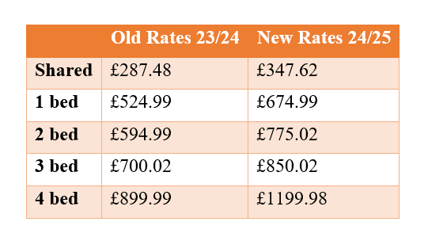
Bond assistance
The criteria to receive this support is:
The property must be affordable to the customer. We will carry out certain checks to ensure this.
The landlord must be willing to accept an inspection from Leeds City Council and provide the necessary documentation.
If a customer find a property outside of Leeds, we will not need to carry out an inspection, but we will need the landlord to send us certain safety documents such as the EPC.
Please be aware we cannot pay the bond to the customer, it must be paid to the landlord after safety checks are carried out.
Anyone can apply for bond assistance including single customers under 35 for HMO properties.
A customer cannot move into a property then request bond assistance. They must wait for the bond process to be carried out and once the bond is paid, they can move in.
If a customer would like to request bond assistance, please get in touch with their housing advisor to request a bond assistance form. The advisor can also support with completion.
Through our private rented scheme, we can offer bond support to customers meaning we can pay their deposit and first month's rent on a private rented property.

Slide 10
Migration support
People seeking asylum
Refugee
United Nations definition:
When people flee their own country and seek sanctuary in another country, they apply for asylum – the right to be recognised as a refugee and receive legal protection and material assistance. An asylum seeker must demonstrate that his or her fear of persecution in his or her home country is well-founded.
Refugee Council's definition:
In the UK, a person becomes a refugee when government agrees that an individual who has applied for asylum meets the definition in the Refugee Convention they will “recognise” that person as a refugee and issue them with refugee status documentation

Slide 11
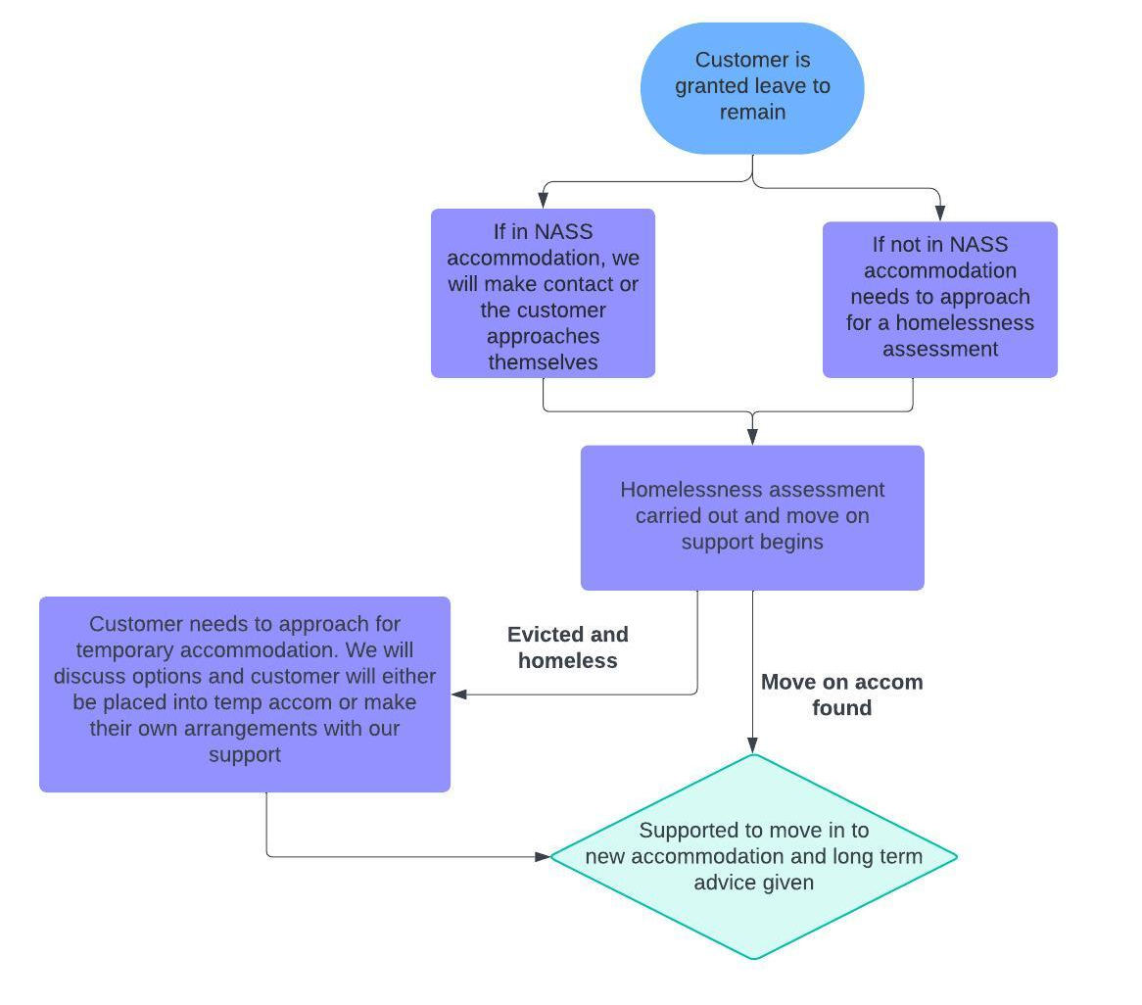
What is the process for housing support when an Asylum Seeker is granted leave to remain?
We will continue to give customer move on support via private rented, supported housing referrals or social housing

Slide 12
Temporary accommodation
If a customer is needing temporary accommodation, they need to approach the service either at the Merrion House hub or via the phone.
Initially their caseworker will do some checks to confirm homelessness. This includes checking they cannot return to the accommodation they are homeless from (unless it is unsafe to do so), checking with friends or family if they can accommodate the customer and any other checks that could be relevant.
Once homelessness is confirmed, the temporary accommodation team will look for a suitable placement. A suitability assessment is carried out against placements made this includes checking distance to school, workplace, support services or if the placement is a risk to applicants' safety.
Households that are pregnant or have dependent children who are placed into B+B accommodation have been placed there as a last resort due to no other accommodation being available. However, the Council is under a duty to ensure that the applicant does not occupy bed and breakfast accommodation for a period, or a total of periods, which does not exceed 6 weeks.
Before or at the 6 week period, we will place the applicant into a self-contained unit and this placement will be indefinite until the applicant is rehoused.
Professionals can use emergency.accomteam@leeds.gov.uk to contact the TA team

Slide 13
Applicant needs housing assisstance
The applicant is homeless tonight
Call Housing Options on 0113 222 4412 (Option 3)
The applicant is threatened with homelessness
Submit a DTR via Jigsaw or email to Duty to Refer
No the applicant is overcrowded, has anti-social behaviour, cannot afford their rent, has support needs to move
Is the applicant homeless?
Please email Housing.options@leeds.gov.uk with your enquiry and attach any supporting evidence.
No, the applicant requires adaptations for their phsycial health needs in the long term and require a move
Contact Health and Housing via email to infomedical@leeds.gov.uk

Slide 14
Important contact information
Duty to Refer | To submit a Duty to Refer email your referral to: dutytorefer@leeds.gov.uk
Housing Options | To submit a general enquiry which is not relating to homelessness or updates please contact Housing.Options@leeds.gov.uk . Our telephone line is for homeless tonight customers only.
Review Panel | To review a recent decision on an applicants case email: reviewpanel@leeds.gov.uk
Hospital team | To contact the Hospital discharge team email: H.H.HospitalAccomTriage@Leeds.gov.uk
Private Sector Lettings | To submit a request for a deposit for a private tenancy contact psls@leeds.gov.uk
Health and Housing | To request a Housing needs assessment for physical health / mobility contact: infomedical@leeds.gov.uk
Sanctuary referral | To request a sanctuary installation please contact: dv.marac@leeds.gov.uk
Disrepair | To report disrepair in a private property contact Private Rented Housing team 0113 378 4699 or prs.housing@leeds.gov.uk

Slide 15
Useful Links
Start | Housing Advice | Leeds City Council (adviceaid.uk)
Social Housing Picker (imactivate.com)
New to Leeds - A guide for migrants moving to Leeds from abroad
Help in Leeds

Slide 16
Any questions?

