Slide 1
Illegal Migration Act:
Impacts
Leeds Strategic Migration Board
October 2023
Mary Brandon, Asylum Matters

Slide 2
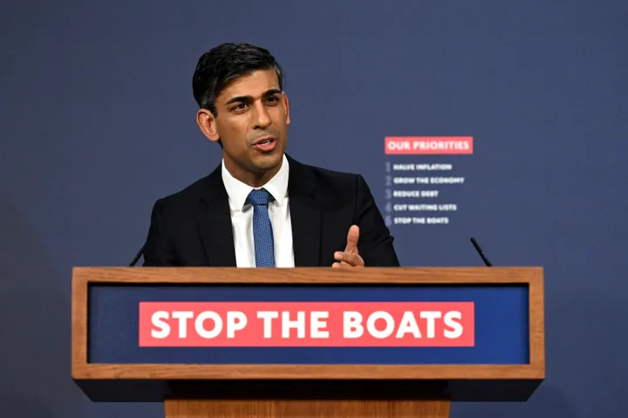
Background
In 2022, the top five countries of origin of people seeking asylum were Iran, Albania, Iraq, Afghanistan, and Syria.
89,398 people claimed asylum in the UK in 2022
In terms of the number of asylum applications per head of population, the UK ranks
Recognition rates:
of initial decisions are grants of protection
of asylum appeals are allowed
20th highest in Europe.
75%
44%
Notes:
Stats from Ref Council: https://www.refugeecouncil.org.uk/information/refugee-asylum-facts/top-10-facts-about-refugees-and-people-seeking-asylum/
There were 74,751 asylum applications (relating to 89,398 people) in the UK in 2022, a 49% increase from 2021. The increase in applications is likely to be due to the continued global increase in the number of people displaced due to war and conflict.

Slide 3
Illegal Migration Act:
destroying the right to seek safety
Duty to remove all irregular arrivals except separated children (until they turn 18), unless for family reunion, and some survivors of modern slavery
Makes many asylum claims permanently “inadmissible”
Those not removed:
subject to detention (including children and pregnant women)
destitute or on S4 support
unable to work
Those deemed “inadmissible” cannot apply for leave, subject to a lifetime ban on immigration status or British citizenship, including for UK-born children
Notes:
https://www.refugeecouncil.org.uk/wp-content/uploads/2023/03/Refugee-Council-Asylum-Bill-impact-assessement.pdf
https://researchbriefings.files.parliament.uk/documents/CBP-9747/CBP-9747.pdf
Definition of irregular arrivals:
The IMA places a new duty on the Home Secretary to take steps to remove anyone (and their family members) who fulfils the following four conditions:
○ They entered the UK in breach of immigration rules;
○ They arrived on or after 7 March 2023;
○ They didn’t travel directly from the country they’re seeking protection from;
○ They require leave to remain in the UK but don’t have it.

Slide 4
Illegal Migration Act:
huge expansion of detention
The bill contains extensive powers to detain people, allowing the detention of families with children and pregnant women
no time limits applying
people unable to apply to the courts for bail within the first 28 days.
Duty to remove people
Back to a ‘safe’ home country
To a ‘safe’ third country - only agreement is with Rwanda
This will leave tens of thousands of people in permanent limbo, in fear of being detained and forcibly removed from the UK.
Notes:
https://www.refugeecouncil.org.uk/wp-content/uploads/2023/03/Refugee-Council-Asylum-Bill-impact-assessement.pdf

Slide 5
Who does this apply to?
“Irregular” arrivals
The new duty on the Home Secretary to take steps to remove anyone (and their family members) applies to anyone who fulfils the following conditions:
They entered the UK in breach of immigration rules;
They arrived on or after 7 March 2023;
They didn’t travel directly from the country they’re seeking protection from;
They require leave to remain in the UK but don’t have it.
Notes:
https://www.refugeecouncil.org.uk/wp-content/uploads/2023/03/Refugee-Council-Asylum-Bill-impact-assessement.pdf
https://www.refugeecouncil.org.uk/wp-content/uploads/2023/03/Refugee-Council-Asylum-Bill-impact-assessement.pdf
Definition of irregular arrivals:
The IMA places a new duty on the Home Secretary to take steps to remove anyone (and their family members) who fulfils the following four conditions:
○ They entered the UK in breach of immigration rules;
○ They arrived on or after 7 March 2023;
○ They didn’t travel directly from the country they’re seeking protection from;
○ They require leave to remain in the UK but don’t have it.

Slide 6
How many people will this apply to?
Refugee Council impact assessment: In the first three years of the legislation coming into effect, between 225,347 and 257,101 people will have their asylum claims deemed inadmissible.
This includes between 39,500 and 45,066 children.
Rhetoric vs reality: 3 years into implementation, between 161,147 and 192,670 people will have had their asylum claims deemed inadmissible but will not have been removed.
Notes:
https://www.refugeecouncil.org.uk/wp-content/uploads/2023/03/Refugee-Council-Asylum-Bill-impact-assessement.pdf
Definition of irregular arrivals:
The IMA places a new duty on the Home Secretary to take steps to remove anyone (and their family members) who fulfils the following four conditions:
○ They entered the UK in breach of immigration rules;
○ They arrived on or after 7 March 2023;
○ They didn’t travel directly from the country they’re seeking protection from;
○ They require leave to remain in the UK but don’t have it.

Slide 7
Key groups in our communities
Those who don’t claim asylum (or leave the process) may become undocumented although actually potentially refugees
Asylum seekers in backlogs – pre NABA, NABA to Act (no longer retroactive to March)
Duty to remove – detained – adults or families or UASCs
Duty to remove – not detained - adults or families or UASCs
Asylum seekers who come via regular routes
Others affected e.g. all irregular migrants not just those needing protection, victims of trafficking
Notes:
https://www.refugeecouncil.org.uk/wp-content/uploads/2023/03/Refugee-Council-Asylum-Bill-impact-assessement.pdf

Slide 8
Impacts on people
Lots expected to go underground, become undocumented, in fear of detention or removal.
Modern slavery and exploitation risk increased significantly- people have no ability to work legally and can’t reveal themselves to authorities, even if victims of crime, a condition which is ruthlessly exploited by individuals and criminal gangs.
Expected to be reluctant to use or share information with services
Some people are choosing to leave the UK (anecdotally); others are saying they “will not stop coming: it’s better to die trying”
Suggestion that other more clandestine migration routes will be used to avoid detection (and so more at risk including of exploitation)
Severe mental health impact: high levels of suicidal ideation already reported
Mental health impacts for children in foster care who “watch the news and know what is going on. Children need hope, they need that hope that they're going to have a better life”. Anticipated impact on children’s engagement with education, therapy etc.
Notes:
On the basis of a person’s earlier presence in or connection to a safe third country, even if that particular country will not immediately agree to the person’s return.
Permit removal to any safe third country that will take them.
Included (=reinforced) in the Nationality and Borders Act
1 January 2021 - 30 June 2022:
15,898 people were issued with ‘notices of intent’
51% have received a decision
of which 99% were subsequently admitted into the UK asylum system.

Slide 9
Impacts on services
(LA Homelessness & Children’s Services, VCS)
Major safeguarding implications, particularly for children
Sharpening of issues around data sharing
Contradictions in duties of care
Sharp increase in vulnerabilities, destitution etc
Lack of access to legal advice therefore lack of ability to challenge breaches of law and human rights abuses (FYI In 2022 25,000 people seeking asylum (45%) were unable to access legal aid advice, up from 6000 in 2021)
Supporting with complex trauma, with no legal/logistical solution available
Implications for trust-building- avoidance of services if data is shared with Home Office
Vicarious trauma and burn-out among staff in services - impact of not being able to help if law forbids providing help
Mental health implications
Section 17 due to increase significantly
Media implications- for example, for Local Authorities who have unaccompanied asylum seeking children in their care who go missing after “absconding” (leaving the asylum system) due to fear of detention and removal e.g. Brighton and Hove.
Notes:
On the basis of a person’s earlier presence in or connection to a safe third country, even if that particular country will not immediately agree to the person’s return.
Permit removal to any safe third country that will take them.
Included (=reinforced) in the Nationality and Borders Act
1 January 2021 - 30 June 2022:
15,898 people were issued with ‘notices of intent’
51% have received a decision
of which 99% were subsequently admitted into the UK asylum system.

Slide 10
Illegal Migration Act:
Impacts on legal services
Legal representatives will be able to do very little to assist, there are very few legal services to be offered to prevent detention and/or removal, except out of time suspensive claims, JR / habeas corpus / bail procedures, and any strategic litigation
Some have no capacity to provide services under IMA or capacity is v limited + legal aid deserts.
No capacity to run cases in 8 days.
Many will have to re-train.
Retention and recruitment a huge challenge.
Shift from domestic cases to non-suspensive appeals, Strasbourg claims etc.
Need for urgent, possibly shorter, medico-legal reports Ties in with MEX report that lack of legal advice is the new norm and a sector-wide strategy is needed
Notes:
On the basis of a person’s earlier presence in or connection to a safe third country, even if that particular country will not immediately agree to the person’s return.
Permit removal to any safe third country that will take them.
Included (=reinforced) in the Nationality and Borders Act
1 January 2021 - 30 June 2022:
15,898 people were issued with ‘notices of intent’
51% have received a decision
of which 99% were subsequently admitted into the UK asylum system.

Slide 11
Discussion: how to respond/prepare
Evidence support provided (by VCS and by local authorities), and use this to challenge the policies
Maximise immigration advice provision- to ensure legal challenges to the policies at individual and strategic level
Sharing best practice: Learn from organisations who already work with people marginalised from safety nets and protections- people with NRPF, people who have had their asylum claims refused, undocumented people..
Sustainability and well being prioritised for staff and volunteers, as well as service users
Local authorities and health authorities- develop safeguards e.g. migrant champions, firewalls, funding in-house or local-specific legal advice, invest in migrant homelessness strategies
Notes:
On the basis of a person’s earlier presence in or connection to a safe third country, even if that particular country will not immediately agree to the person’s return.
Permit removal to any safe third country that will take them.
Included (=reinforced) in the Nationality and Borders Act
1 January 2021 - 30 June 2022:
15,898 people were issued with ‘notices of intent’
51% have received a decision
of which 99% were subsequently admitted into the UK asylum system.

Slide 12
Leeds responses
“With these anti-refugee laws, the Government is closing their eyes and throwing people back to war and persecution.” Kidist Teklemariam
Deputation to Leeds City Council September 2023
https://leeds.public-i.tv/core/portal/webcast_interactive/799246

Slide 13
Contact details
Email: mary@asylummatters.org
Website
www.asylummatters.org
Twitter
@AsylumMatters

