Slide 1
Palm Cove Society & PCS Training
Jordan Alexander
Senior Manager
(Safeguarding / Partnerships / Development)
National Chairperson for ALWSPA

Slide 2
How Did it All Begin?
In 2007 Yvonne and Gerard, our founders, decided to create something to help others that were in a void and no options of help from others
Became one of the first safehouse providers for survivors of MSHT in the UK.
Largest support provider of safehouses in the UK.
DA survivors with NRTPF (IAU).
Have helped and supported thousands of survivors of MSHT.
Building them new lives, free form harm and risk.
Empowering them to regain independence.
Healthy and safe employment – free from harm or abuse.

Slide 3
Modern Slavery
Domestic Servitude
ALWSPA
Sexual Exploitation
Squaring
49.8 million - Worldwide
135,000 - UK
Organ Harvesting
County Lines
Debt Bondage
Cuckooing
Forced Criminality
Forced Labour
Forced Marriage

Slide 4
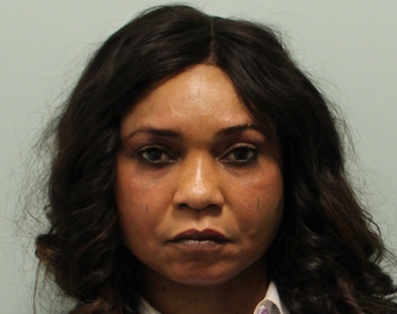
Abuse Linked to Witchcraft and Spiritual Possession Accusation.
The abuse of one person by another, in the belief they are evil, possessed, or a witch.
The abuse involves torture, starving, drowning, burning – anything in order to ‘remove’ what the abuser considers is evil spirit from the person they believe to be possessed.
Used heavily in Human trafficking, Modern Slavery and Controlling Coercive Behaviour within Nigerian OCG’s – JUJU or Kindoki Rituals
Brazil – Black Magic Sexual Exploitation

Slide 7
Statistics
6%
15%
34%
79% Male
82%
15 – 17 years
County Lines
31%
99%

Slide 8
NRM – National Referral Mechanism
The NRM is a framework for identifying and referring potential victims of slavery and ensuring the receive the appropriate support.
Once referred to the NRM the time taken by service. providers such as Palm Cove Society can range from 30 days to 3 years in extreme cases, (av 561 days).
All the time they are being fully supported by us, where we will seek to then work in partnership with others to ensure they get the best start, at a new life, free from harm or risk of abuse.

Slide 9
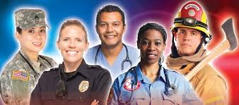
First Responders / Assessments
Police – including PSNI, BTP and Police Scotland
Border Forces
HMRC
NCA
BAWSO
NSPCC
Barnardo's
GLAA
Medaille Trust
Social Services / Local Authorities
Unseen
Migrant Help
Salvation Army

Slide 10
The NRM Journey
Victim is located or identified by First Responder
Referred to the SCA (Home Office)
‘Reasonable Grounds’
Directed to an authorised Safehouse
Reflection and Recovery Period
Support
Conclusive Grounds
Move on into society

Slide 11
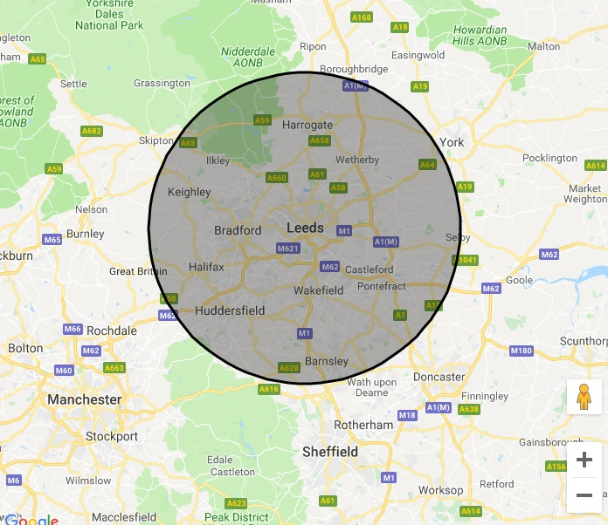
Danger area
20 miles at least… away from their place of exploitation
The survivor is free to decline a safehouse and can, if they wish, live in the community, at risk of harm and exploitation.

Slide 12
Support
Legal
Medical (within 5 days)
Safe accommodation (security, staff, CCTV)
Therapy
Activities
Community engagement
Healthy and safe employment
Housing
Budgeting
Drug and Alcohol Rehab’
Immigration
Police investigations
Compensation
Education and language skills (CPD)

Slide 13
Partnerships
Drug and Rehab’ Services
NHS – Leeds General Infirmary Safeguarding Team
Housing
Probation
Women's Aid
IAU
Leeds Local Authorities
Social Services
Crisis Teams
LYPFT
West Yorkshire Police
NCA
Parliament

Slide 14
Nationality and Borders Act 2022

Slide 15
Terminology
Modern Day Slavery – now just ‘Victim of Slavery’
Human Trafficking – ‘Trafficking’

Slide 16
RG Thresholds
Old test: “suspects but cannot prove” that someone is a potential victim of modern slavery/there are reasonable grounds to believe the person may be a victim of slavery or human trafficking.
New test: there are “reasonable grounds to believe, based on objective factors but falling short of conclusive proof, that a person is a victim of modern slavery (human trafficking or slavery, servitude, or forced or compulsory labour)”.
Objective factors must do more than corroborate a potential victim’s journey
“To be sufficient to meet the reasonable grounds threshold, the referral will typically need to be supported by specific external corroborating information or evidence.”

Slide 17
Disqualification
Threat to Public Order
Terrorism
Foreign criminality
Deportation is being pursued
Bad Faith
They, or someone acting on their behalf, have knowingly made a dishonest statement in relation to being a victim of slavery

Slide 18
Additional NRM Questions for the FR… What is their background Birthplace, education, family, employment history and working conditions When did the exploitation take place? Have they been in more than one exploitative situation? How did they come to be exploited? Were they taken somewhere by their exploiter(s)? If Yes: Journey details An average day: What were they required to do; how many hours a day they worked; were they allowed breaks etc. How were they treated? Details of accommodation; access to facilities etc. Why they stayed? Were the forcibly detained; whether threats, force or coercion were used against them; whether documents were removed etc. How and why did they leave the situation? Is this the first chance they have had to report this? Yes/No/Not sure Why are you making the referral? Where and how was the interview carried out? Include relevant evidence or information, such as your professional insight; modern slavery indicators; an intention to exploit the individual circumstances which put the individual at a heightened level of vulnerability; safeguarding issues; physical and mental health; support needs; current support being received Are there other professionals or organisations involved with this case? If Yes: Details of other professionals or organisations involved Are there indicators or evidence that they could be acting dishonestly? If Yes: Indicators or evidence of dishonesty (do not include examples of them withholding or changing information if you think they have done this because they have fears for their safety or are trying to avoid reliving their trauma What documents or evidence will you submit with this referral?

Slide 19
PCS Training – what makes us so different?
PCS Training was developed to provide development to others with the understanding that we will only train on subjects that we actively work in. We do not recruit facilitators who no longer work in the area of expertise.
We are a CIC (not for profit) and we re invest the monies we get from organisations and use that to provide training, development to MSHT survivors free of charge.
All courses are CPD accredited and certified
We bespoke the training course to your organisations needs and incorporate their policies and procedures into your learning experience
We use active learning techniques to ensure you get the best out of the subject you are hear to learn about.
WHY DO NOT CHARGE VAT

Slide 20
PCS Training
Gender Based Abuse Awareness*
Abuse Linked to Accusations of Witchcraft and Spiritual Possession
Safeguarding Awareness
Safeguarding Investigation
Slavery & Trafficking - and the NRM Process
Mental Health First Aid
Equality Diversity and Inclusion
Domestic Abuse
County Lines*
Professionalism in the Workplace
Referral Writing
The Role of a Designated Safeguarding Person/Lead

Slide 21
Contact Jordan.a@palmcovesociety.com enquiries@pcstraining.org 07485 306 830

