Slide 1
MIGRATION AND HOUSING

Slide 2
Migration and Housing
What did we say in relation to the strategy we would do
Background to housing market in Leeds
What is the offer from housing

Slide 3
Strategy – how can we help to deliver it
Better partnership with migration colleagues
Share data/area profiles based on crossing the threshold

Slide 4
Housing Market in Leeds
22% of the housing market is private rented and has grown significantly
Decrease in O/O and social sector
75,000 + PRS in city
Mainly found in pre 1919 stock – 50% of sector
No single PRS market – covers differing needs (professional, student, budget, long term, short term).

Slide 5
Housing Market in Leeds
Increase demand for homes – all tenures
Supply not keeping up with need
Increase demand for T/A over last year

Slide 6
Rents in PRS
No means to control rent increases – market/demand driven
Decreasing PRS available for LHA/low income/ issues of affordability
9.4% increase in rent in year to Jan 23

Slide 7
Affordability of PRS
Property | LHA (pcm 23/4) | Ave Leeds Rent (May 23) | LS11 | LS7
One bed | £524.99 | £841 | £633 | £871
Two bed | £594.99 | £1,195 | £1,119 | £1,029
Three bed | £700.99 | £1,280 | £1,303 | £1,200
Four bed | £899.99 | £1,590 | £985 | £1,005

Slide 8
The Private Rented Sector
Good quality accommodation – market driven
Inner city markets seen largest increase
Poorest quality in inner city

Slide 9
Private Sector Housing
Role to improve standards
Legal powers to address poor homes – Challenges -
HHSRS, Providers' understanding of legal compliance, Penalties
Aim to cross the threshold address more than just bricks and mortar

Slide 10
Private Sector Housing
Self Regulation – Leeds Rental Standard
7% of PRS covered
Mainly in student market

Slide 11
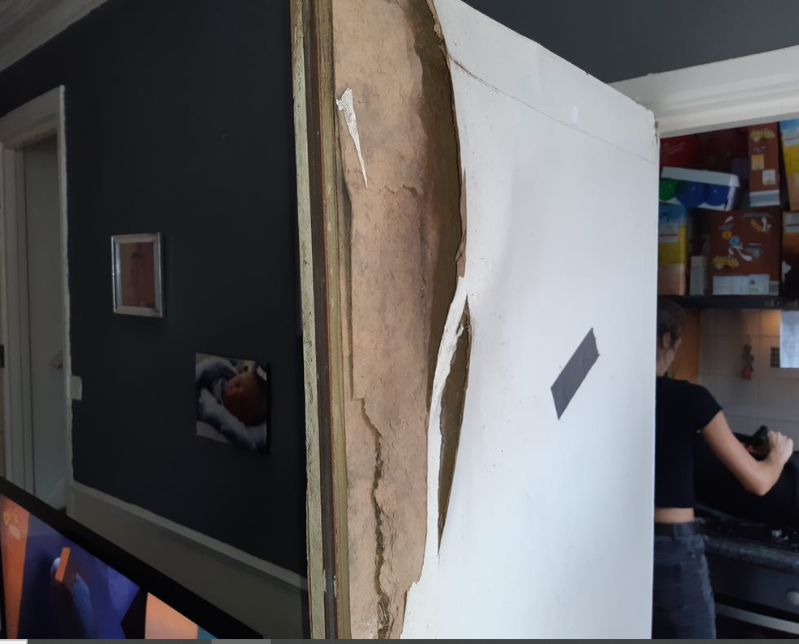
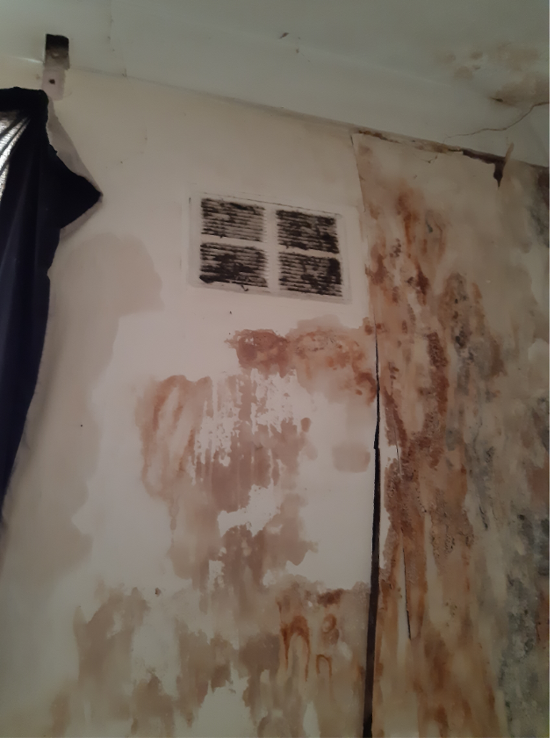
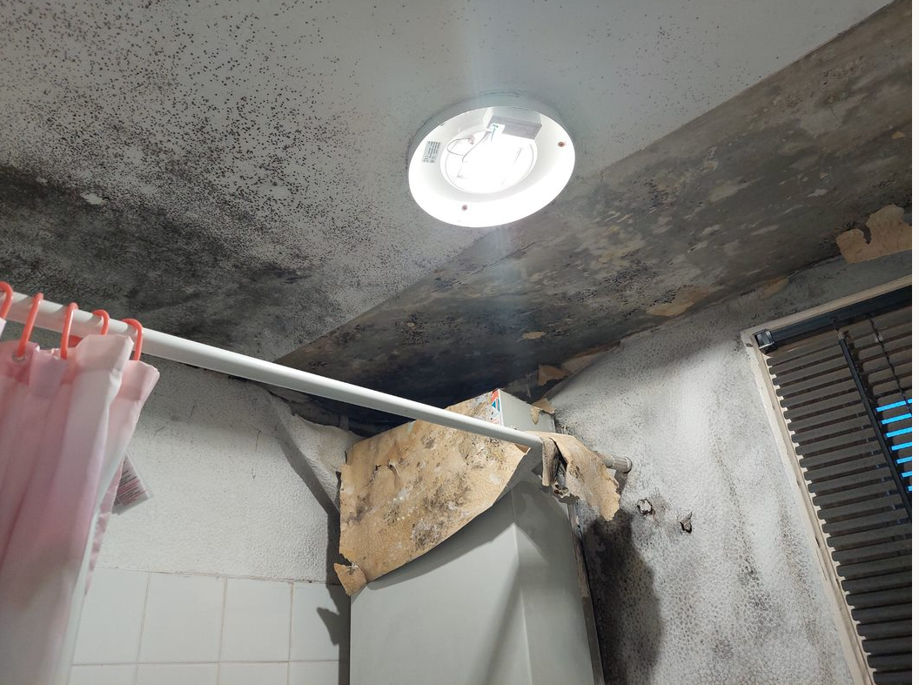
Private Sector Housing
Reactive function – complaints/referrals

Slide 12
Private Sector Housing
Proactive functions
Selective licensing – Beeston and Harehills
Rogue Landlord Unit
Leeds Neighbourhood Approach
HMO licensing

Slide 13
Changes to HMO licensing
New properties exempt until June 25
Existing licences remain and will need to need renewed
Still covered by all other pieces of legislation

Slide 14
Private Sector Housing
Opportunities – cross the threshold in some of most hard to reach communities
Opportunities to make a difference to lives

Slide 15
Opportunities to make the difference
I suffered a really bad back injury at work just over a year ago. I had to reduce my hours and started getting into debt. My emotional health deteriorated. Meeting the team has helped turn my life around. They put me in touch with a debt management officer and helped me find my confidence again. I am now training for new career options and I'm also supporting the people by volunteering. Hearing other stories in volunteering training about people who've experienced physical and mental health challenges has helped me understand my own pains and stresses and to manage them better.
We came across a tenant who was affected by coercive control over several years. All essential referrals were made and we were able to have a good relationship with the tenant and help the tenant get in to regular employment due to using the One Stop Centre where we helped with language, interview techniques and applications. The tenant was successful in their interview and for the first time in years had a regular employer making life easier and more reliable, giving the opportunity to plan ahead and start the healing process that was needed after years of abuse

Slide 16
Leeds Housing Options
Strategy
the longer we have to work with someone less likely to be homeless

Slide 17
Leeds Housing Options
5606 presentations in last 12 months
67% homeless prevention – aware of before eviction
33% homeless on the day

Slide 18
Leeds Housing Options
Dispute resolution – work with all parties to try and keep them in their home
Landlord Letting Scheme - support into the PRS
Evict Alert – allows early intervention
Emergency/Temporary accommodation if required

Slide 19
LHO - LASLO
Asylum Seekers leaving Home Office accommodation with right to remain – 28 days notice
Family reunions - post right to remain
Support into new homes
Ave 12/5 per month

Slide 20
LHO – Resettlement Team
Work in partnership with Refugee Council
Work in hotels in the city
Find homes for use identified via process
Help with homes moves

