Slide 1
Leeds Modern Slavery Board
Leeds Migration Partnership Strategy Group Meeting
19th January 2023

Slide 2
Safeguarding and Domestic Abuse Team
Developing strategic safeguarding partnerships in relation to:
Domestic abuse
Violence against women and girls
Sex work and sexual exploitation
Serious violence
Modern slavery

Slide 3
The Leeds Modern Slavery Board
Leeds City Council​ | West Yorkshire Police​ ​ | Third sector​ ​
Safeguarding and Domestic Violence Team​ | Leeds District Safeguarding​ ​ | Palm Cove​ ​
Migration Team​ | Force Human Trafficking and Modern Slavery Team​ ​ | Basis Yorkshire​ ​
Private Sector Housing​ | Force Intelligence Team​ ​ | Ashiana​ ​
Leeds Housing Options​ ​ | NHS​ ​ | Additional organisations & partnerships​
Children's Social Work Services​ ​ | Leeds and York Partnership Foundation Trust​ ​ | LSAB​
 |  | LSCP​
Adults & Health Commissioning​ ​ | Leeds Community Healthcare​ ​ | West Yorkshire Combined Authority Anti-Slavery Partnerships Team​
Environmental Health​ ​ | West Yorkshire Integrated Care Board​ ​ | Home Office Immigration​
 | Leeds Teaching Hospitals Trust​ ​ | Trading Standards​ ​

Slide 4
Strategy 2020-23
Developing and improving the way partners in Leeds work together to prevent and respond to modern slavery
Focuses on the "4Ps" (national strategy)
Pursue
Prevent
Protect
Prepare

Slide 5
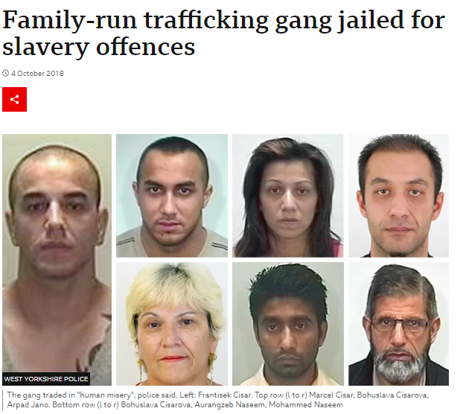
Pursue
Pursuing perpetrators and disrupting activity:
Working together to share concerns and intelligence, allowing the police – and others as appropriate (e.g. GLAA) – to take action
Joint operations e.g. Police, LCC Housing, Leeds Anti-Social Behaviour Team

Slide 6
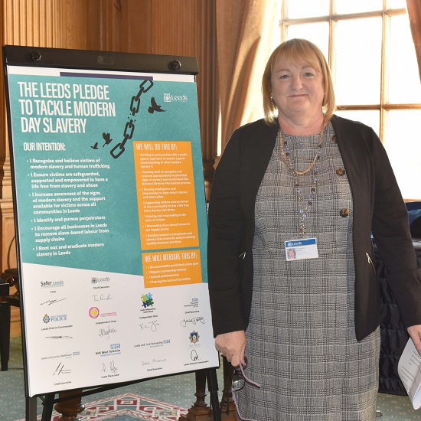
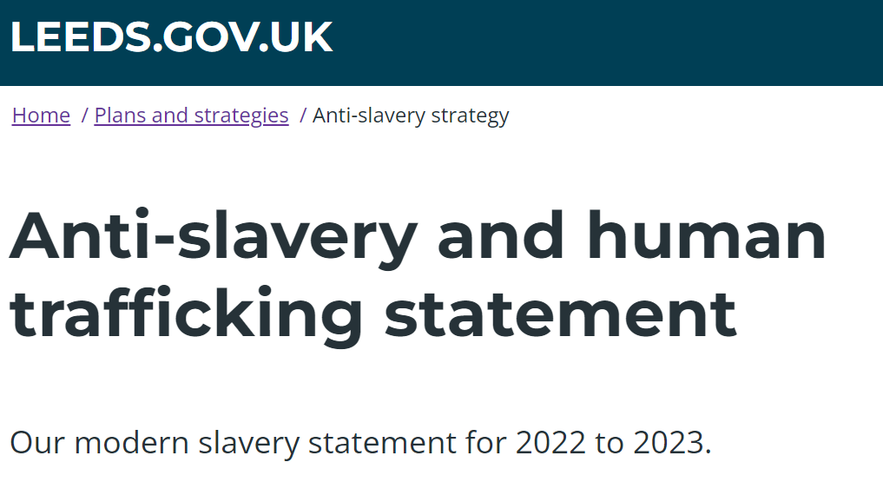
Prevent
Preventing the facilitation of modern slavery in Leeds:
Transparency in supply chains
Raising public awareness of modern slavery (e.g. work of the Migrant Access Project and Migrant Community Networkers)
The Leeds Pledge to Tackle Modern Slavery

Slide 7
Protect
Protect people who are victims or at risk of becoming victims:
Implementing pathways and training around statutory duties: NRM and DtN
Workforce development – awareness raising, training, guidance so workforce understand MSHT and how to recognise and support victims

Slide 8
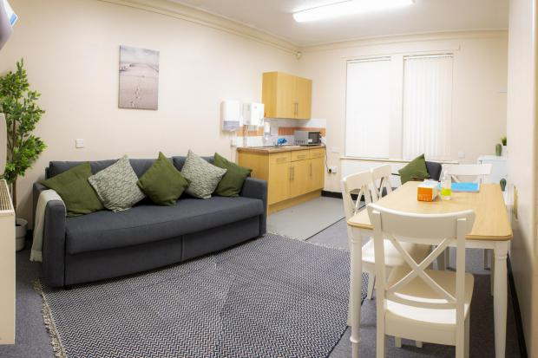
Prepare
Prepare for victims to be well-supported:
Embedding victim pathways
Victim reception centres
Workforce development

Slide 9
Thank you
Any questions?
Partnership working
Link to the Board via the Migration Team
nicola.stewart@leeds.gov.uk

